Slide 1
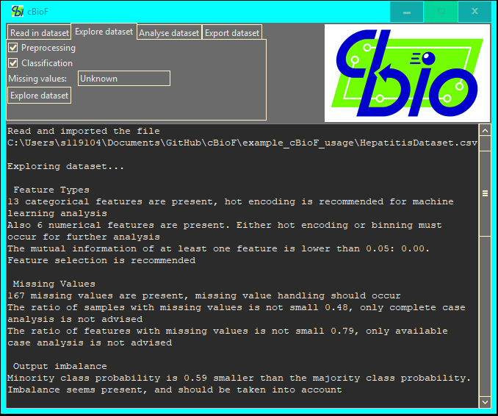
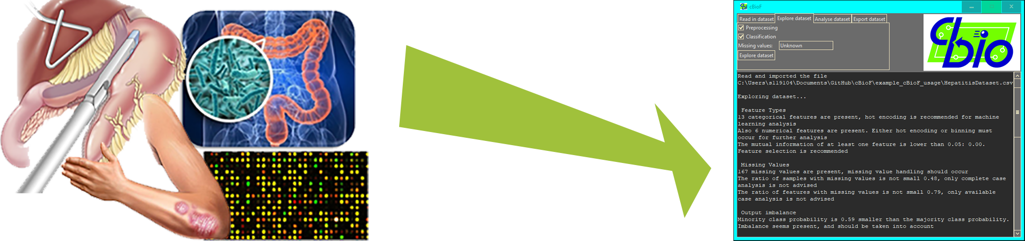
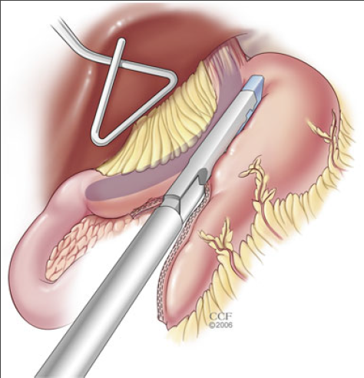

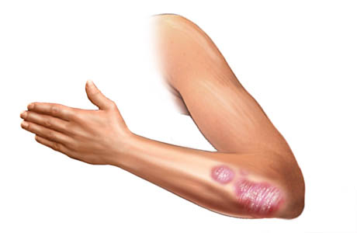
A Computational Biology Framework
A data analysis tool to support biomedical engineers in their research
Tim Beishuizen, October 23rd 2018
Supervisors: Dr. Dragan Bošnački
Dr. Ir. Joaquin Vanschoren
Prof. Dr. Peter Hilbers
University of Technology Eindhoven, department Biomedical Engineering and department Computer Science and Engineering
Notes:
T: 0:30
0:30
Intro 5:00 min

Slide 2
Contents
Introduction
Research questions
Project specifications
Research lines
Feature selection
Missing value handling
Dataset exploration
Framework
Notes:
T: 0:30
1:00

Slide 3
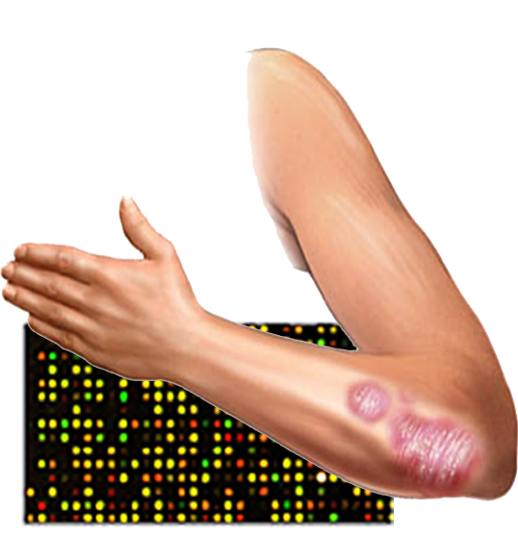
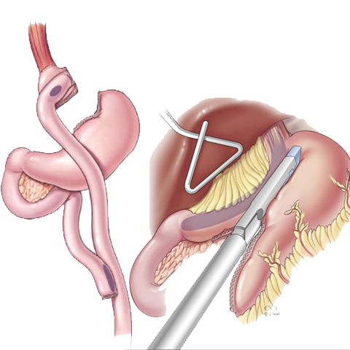
Introduction
Biomedical data
Processing
Analysis
Framework
Notes:
T: 1:00
2:00

Slide 4
What aspects are of importance to be included in a framework for Biomedical Engineers for more efficient data analysis?
Main research question
Datasets Preprocessing methods
Data issues Analysis methods
Notes:
T: 0:30
2:30 min

Slide 5
Sub-questions
What feature selection methods show the best performance and as such should be added to the framework?
What missing value handling methods show the best performance and as such should be added to the framework?
Which initial analyses help find suitable preprocessing and data analysis algorithms?
Notes:
T: 0:30
3:00

Slide 6
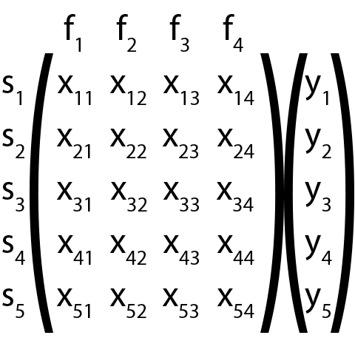
Project description
Statistics
Machine learning
Data matrix
Samples (s)
Features (f)
Output (y)
Classification
Python
Notes:
T: 1:00
4:00

Slide 7
Clinical datasets
Data out of a clinic
Missing values
Combining data issues
Survey datasets
Questionnaire data
Missing values
Bias due to subjectivity
Datasets
Microarray datasets
Gene expression
Many features
Big datasets
Mass spectrometry datasets
Protein mass
Many features
Differences between features
Notes:
T: 1:00
5:00

Slide 8
Feature selection
Notes:
T: 1:00
6:00
FS: 9:30 min

Slide 9
Feature selection
What feature selection methods show the best performance and as such should be added to the framework?
Feature selection methods
Filter methods
Wrapper methods
Embedded methods
Datasets
Microarray
Mass spectrometry
Notes:
T: 1:00
6:00
FS: 9:30 min

Slide 10
Filter methods
Separate features

Slide 11
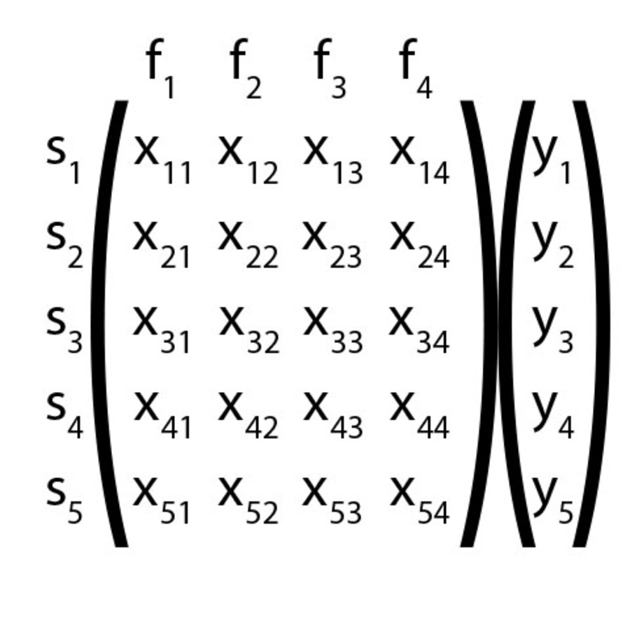
Filter methods
Separate features
Evaluation function
Selection
Fast and simple
Notes:
T: 1:00
7:00

Slide 12
Wrapper methods
Feature sets

Slide 13
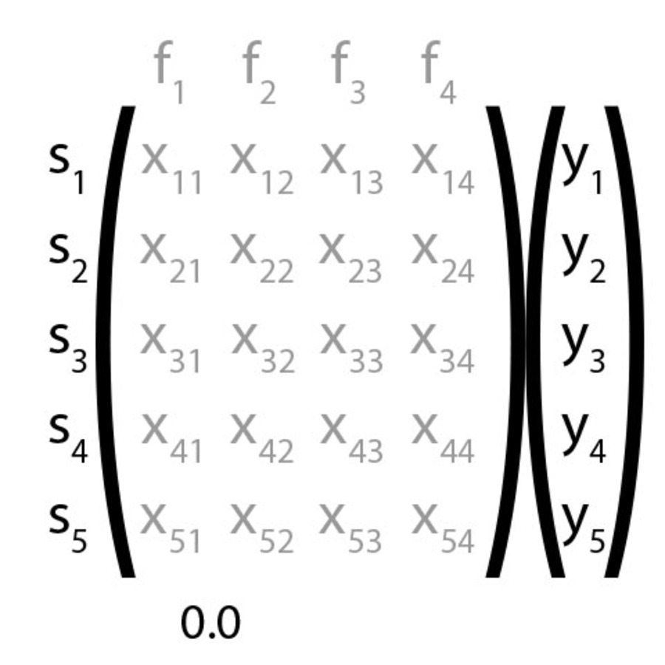
Wrapper methods
Feature sets
Evaluation function
Methods
Forward selection
Backward selection
Combinations
Feature dependencies
Longer computation time
Notes:
T: 1:00
8:00

Slide 14
Embedded methods
Machine learning algorithms

Slide 15
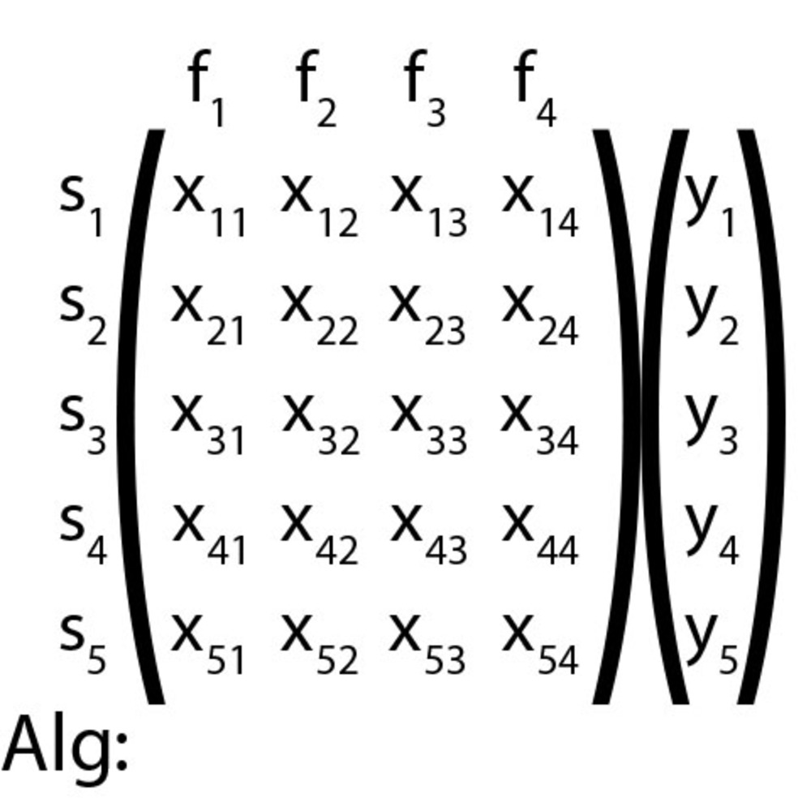
Embedded methods
Machine learning algorithms
Weights
Selection
Low computation time
Some feature dependencies
Notes:
T: 1:00
9:00

Slide 16
Experiment 1
Filter methods
Evaluation functions
T-test/ANOVA
Mutual Information
Feature selection
Minimum 1
Maximum 1000
Quality testing
Logistic regression accuracy ([0, 1])
Notes:
T: 0:30
9:30

Slide 17
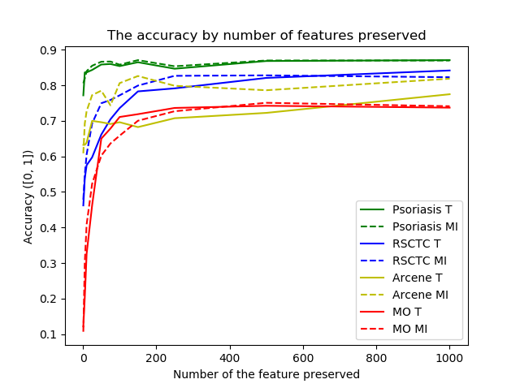
Experiment 1
Evaluation functions
200 features
Notes:
T: 1:00
10:30

Slide 18
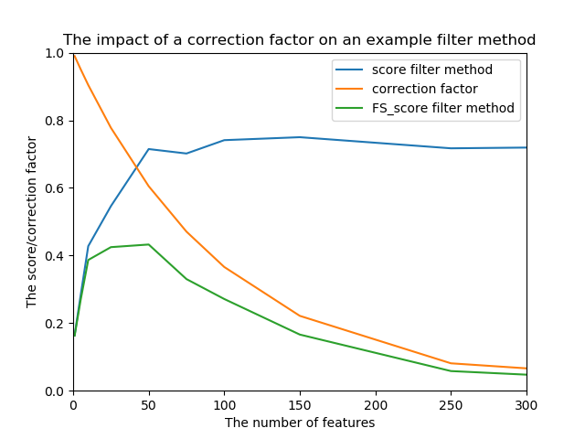
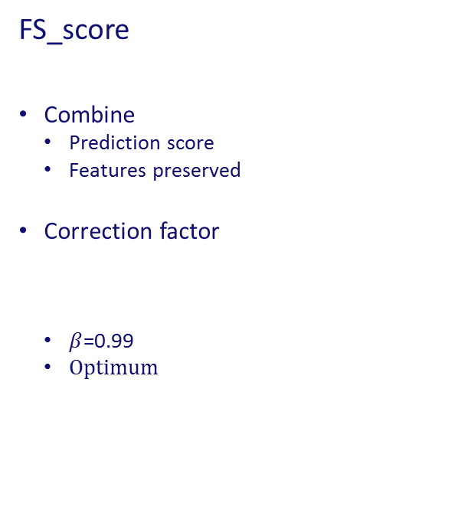
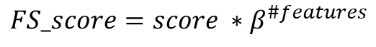
FS_score
Combine
Prediction score
Features preserved
Correction factor
$β$=0.99
Optimum
$$FS_score=score ∗β^{\#features}$$
Notes:
T: 1:00
11:30

Slide 19
Experiment 2
Feature selection methods quality
Quality testing
FS score
Logistic regression accuracy
Notes:
T: 0:30
12:00

Slide 20
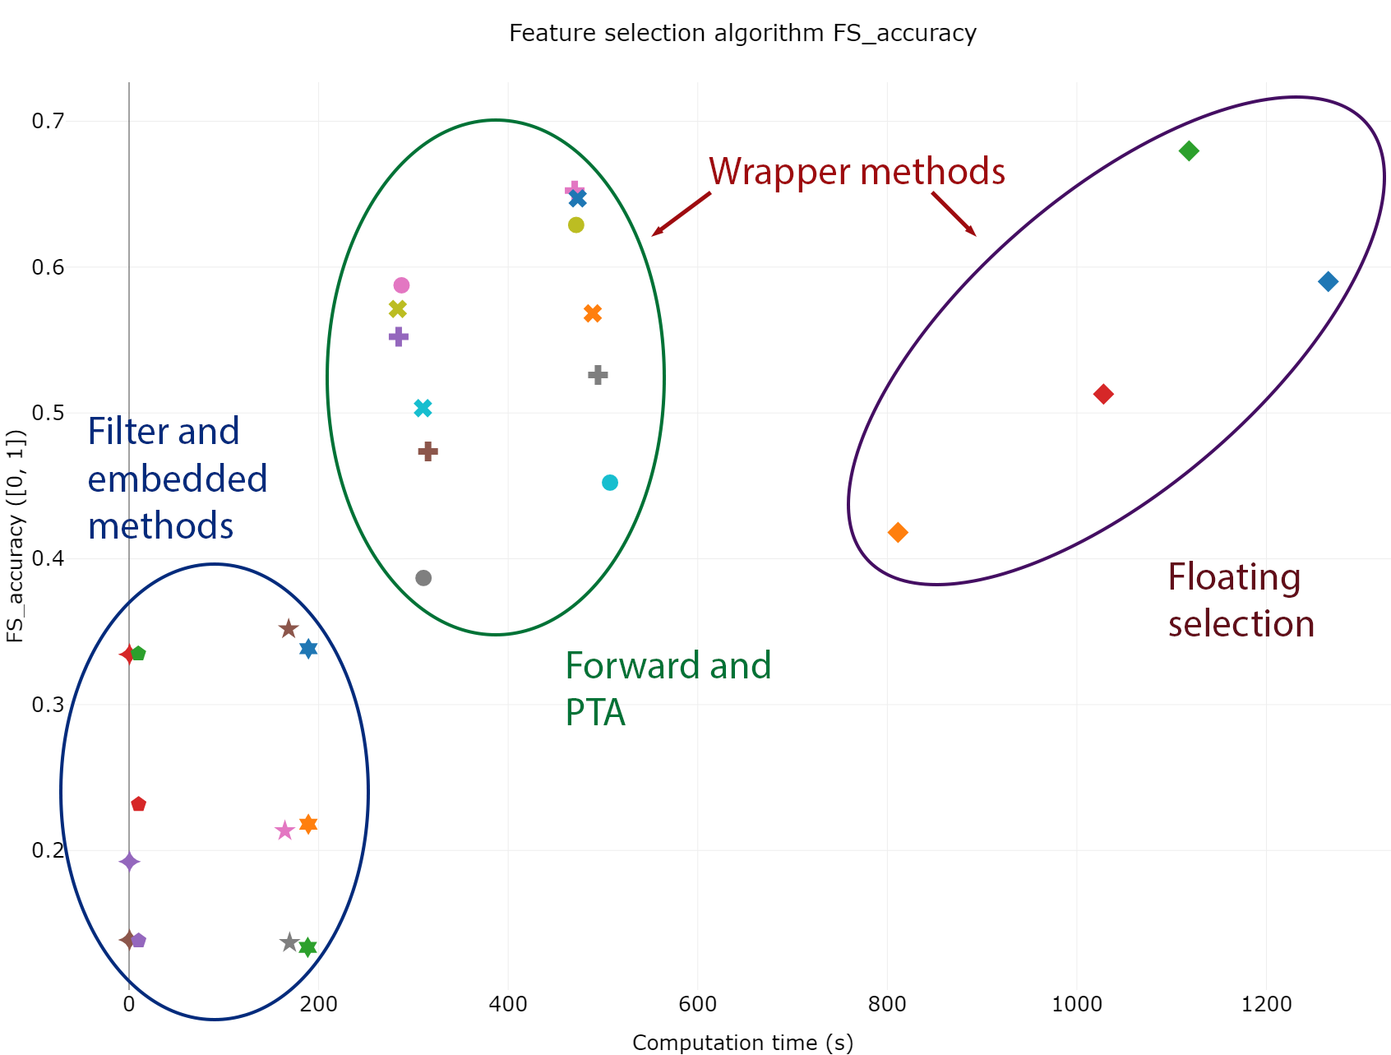
Experiment 2
Filter methods faster
Wrapper methods better
Notes:
T: 1:00
13:00

Slide 21
Experiment 3
Automated machine learning
Search for best analysis
Tree-based Pipeline Optimization Tool (TPOT)
Implements automated machine learning
Sub-optimal for feature selection
FS_accuracy
FS_score
Accuracy
2 Additions
Bias towards feature selection
New set feature selection algorithms
Notes:
T: 0:30
13:30

Slide 22
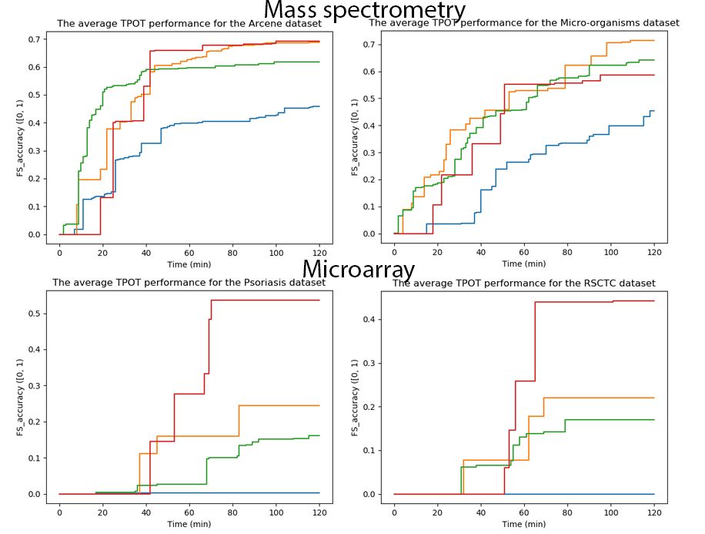
Experiment 3
Improved
Microarray both best
Mass spectrometry debatable
Legend
Blue No addition
Orange New algorithms
Green Feature selection bias
Red Both additions
Notes:
T: 1:00
14:30

Slide 23
Missing Value Handling
Notes:
T: 1:00
15:30
MV: 7 min

Slide 24
Missing Value Handling
What missing value handling methods show the best performance and as such should be added to the framework?
Missing value handling methods
List Deletion
Single imputation
Multiple imputation
Datasets
Clinical
Survey
Notes:
T: 1:00
15:30
MV: 7 min

Slide 25
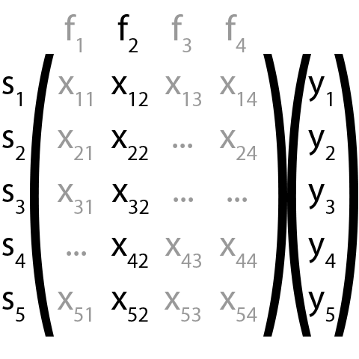


List deletion
Available Case Analysis (ACA)
Complete Case Analysis (CCA)
Weighted Case Analysis (WCA)
Notes:
T: 1:00
16:30

Slide 26
Single imputation

Slide 27
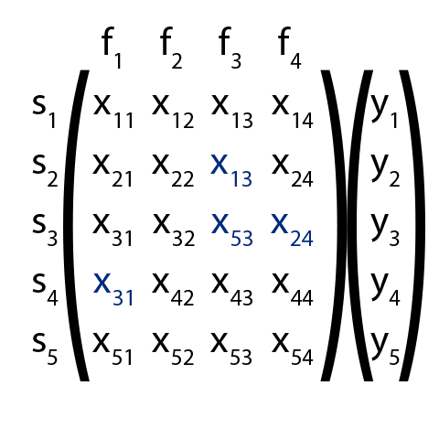
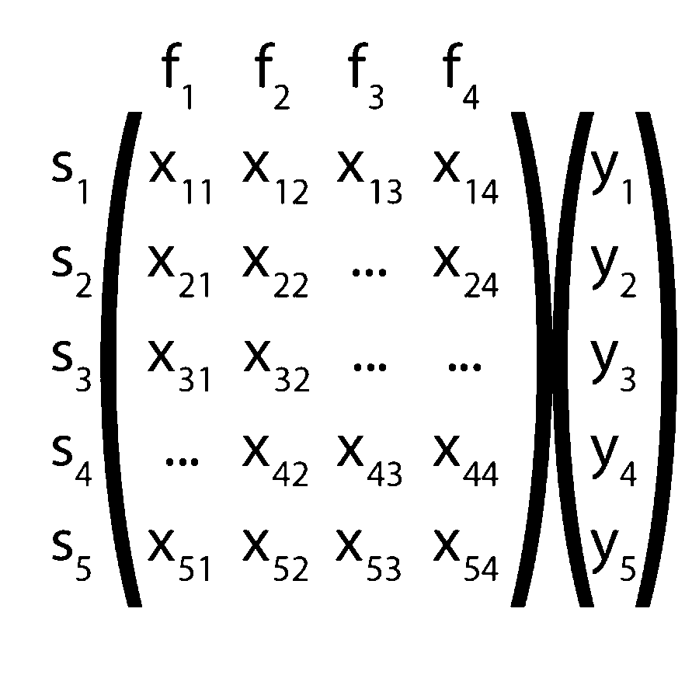
Single imputation
Mean imputation
Median
Mode
Hot deck imputation

Slide 28
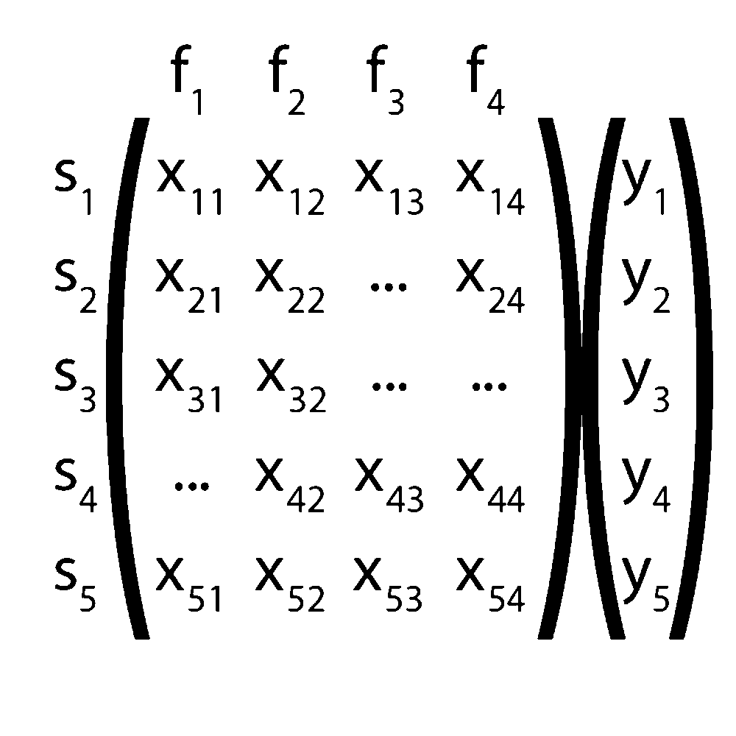
Single imputation
Mean imputation
Median
Mode
Hot deck imputation
Advanced imputation
Regression imputation
Nearest neighbour imputation (kNN)
Notes:
T: 1:00
17:30

Slide 29
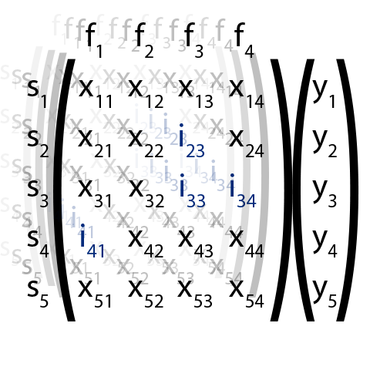
Multiple Imputation
Multiple datasets
Multiple Imputation Chained Equations (MICE)
Notes:
T: 1:00
18:30

Slide 30
Experiment 1
Feature distributions
Mean
Standard deviation
T-test similarity
Notes:
T: 0:30
19:00

Slide 31
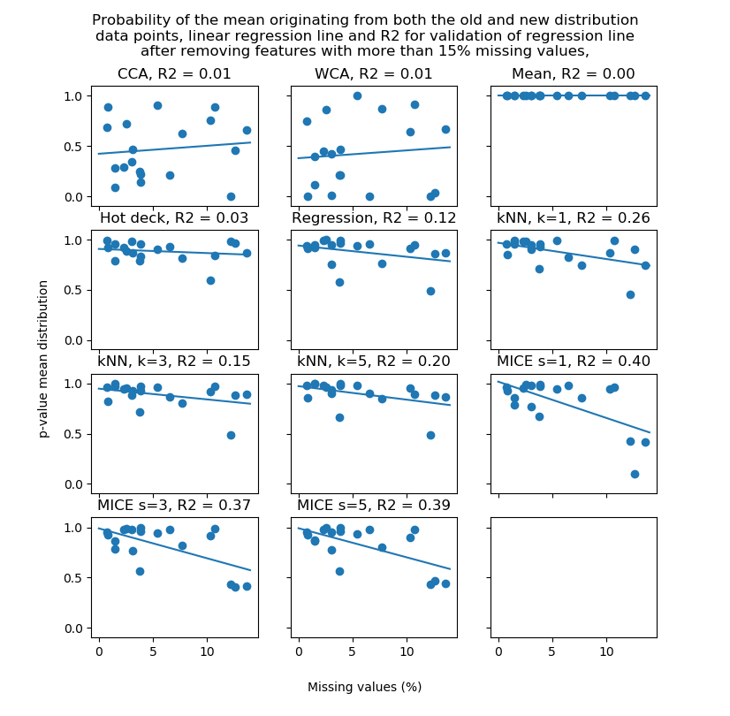
Experiment 1
>15% missing values removed
List deletion
Mean and hot deck
Regression and kNN
MICE
Notes:
T: 1:00
20:00

Slide 32
Experiment 2
Missing value handling quality
>15% missing values removed
Quality output
Logistic regression F1-score
Notes:
T: 0:30
20:30

Slide 33
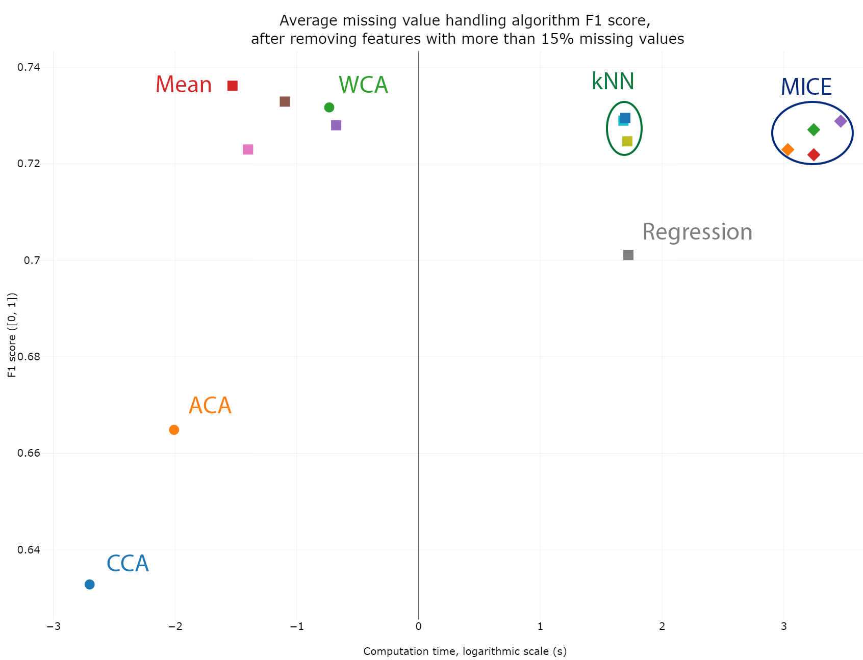
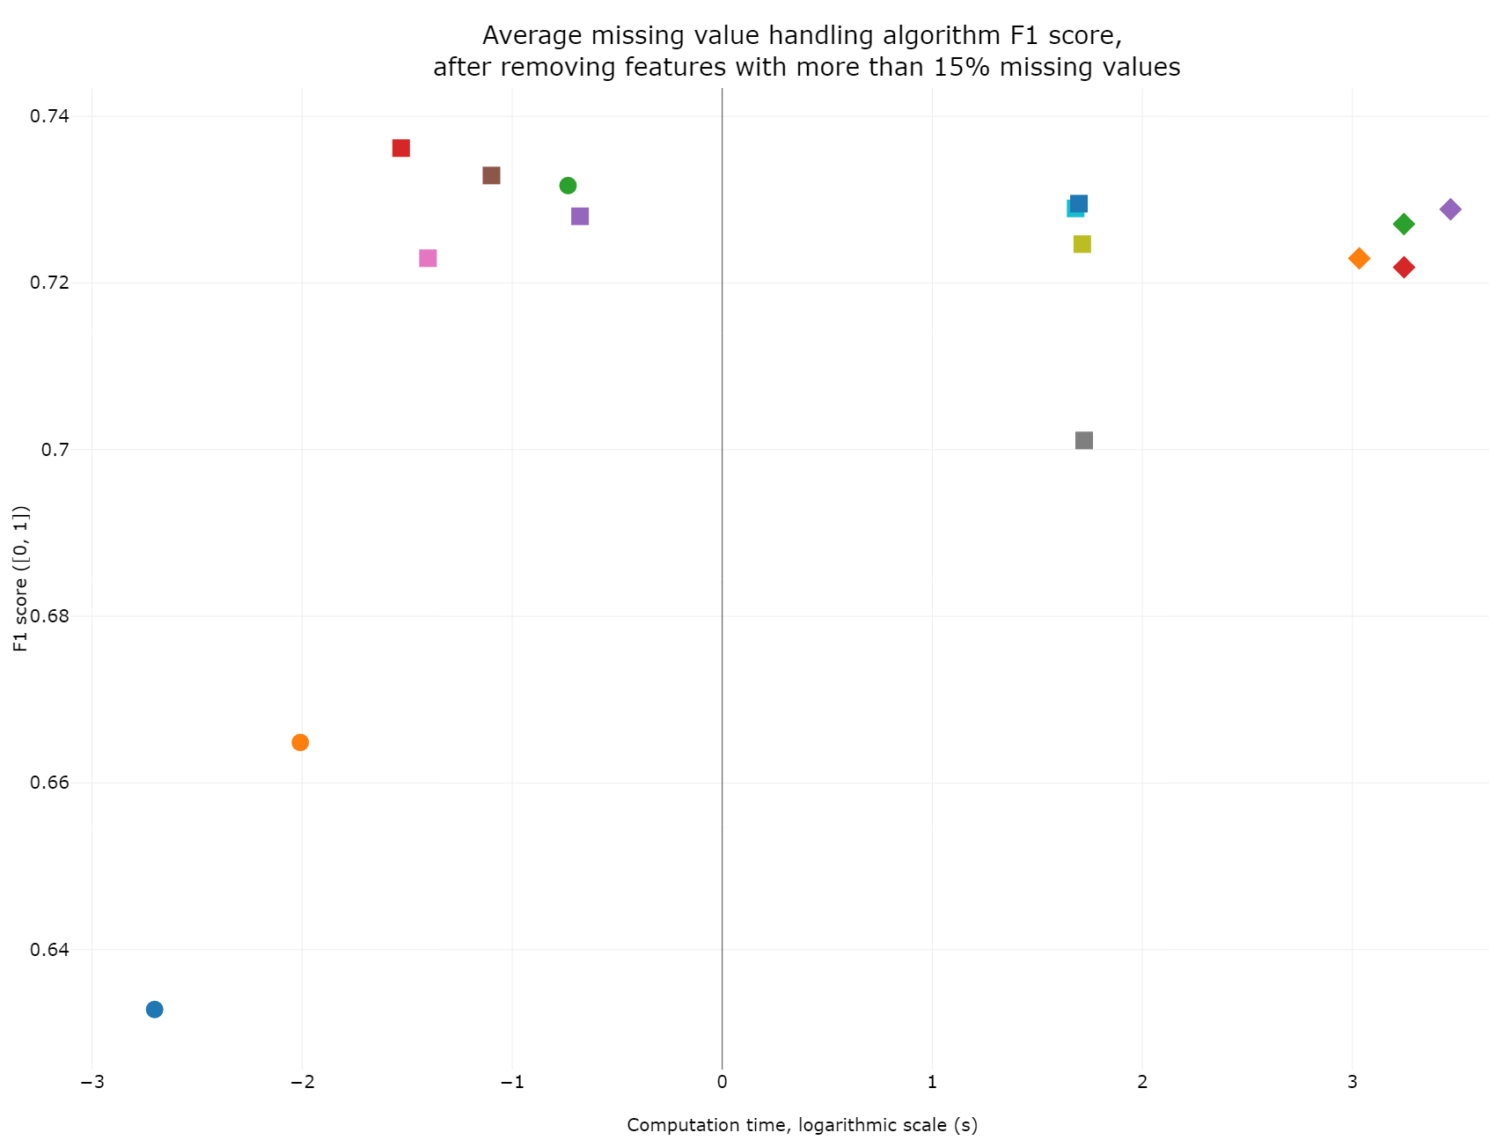
Experiment 2
List Deletion
Mean Imputation
Regression, kNN and MICE
Notes:
T: 1:00
21:30

Slide 34
Dataset exploration
Notes:
T: 1:00
22:30
DE: 3 min

Slide 35
Dataset exploration
Which initial analyses help find suitable preprocessing and data analysis algorithms?
Exploration
Dataset issues
Meta-features
Package metalearn
Datasets
Clinical
Mass spectrometry
Notes:
T: 1:00
22:30
DE: 3 min

Slide 36
Analysis 1
Dataset exploration with package metalearn
Issues <> meta-features
Result
Issues recognizable
Multicollinearity
Feature irrelevance
Needs clarification
Notes:
T: 1:00
23:30

Slide 37
Analysis 2
Dataset exploration with metalearn
Metalearn addition
Added meta-features
Outlier detection
Plots
Results
All issues explained
Better understanding
Notes:
T: 1:00
24:30

Slide 38
Framework cBioF
Notes:
T: 1:00
25:30
FW: 5 min

Slide 39
Framework cBioF
What aspects are of importance to be included in a framework for Biomedical Engineers for more efficient data analysis?
Phases
Datasets
Exploration
Preprocessing
Analysis
Notes:
T: 1:00
25:30
FW: 5 min

Slide 40
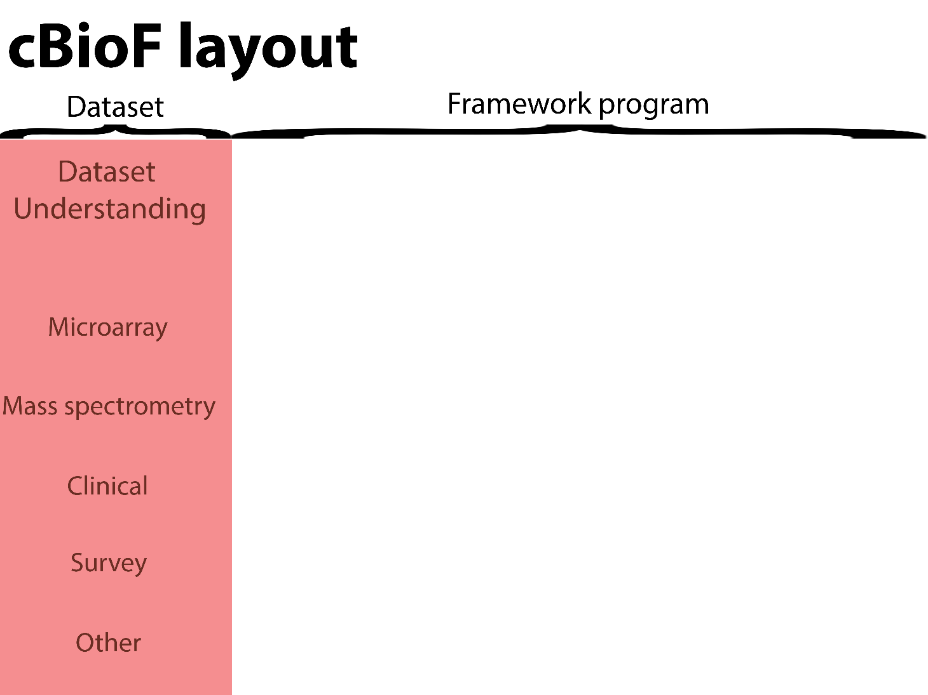

Slide 41
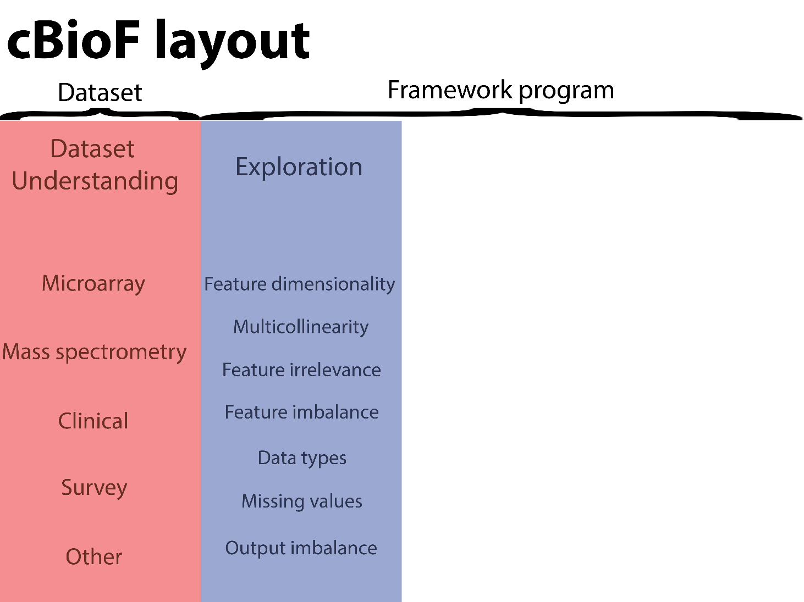

Slide 42
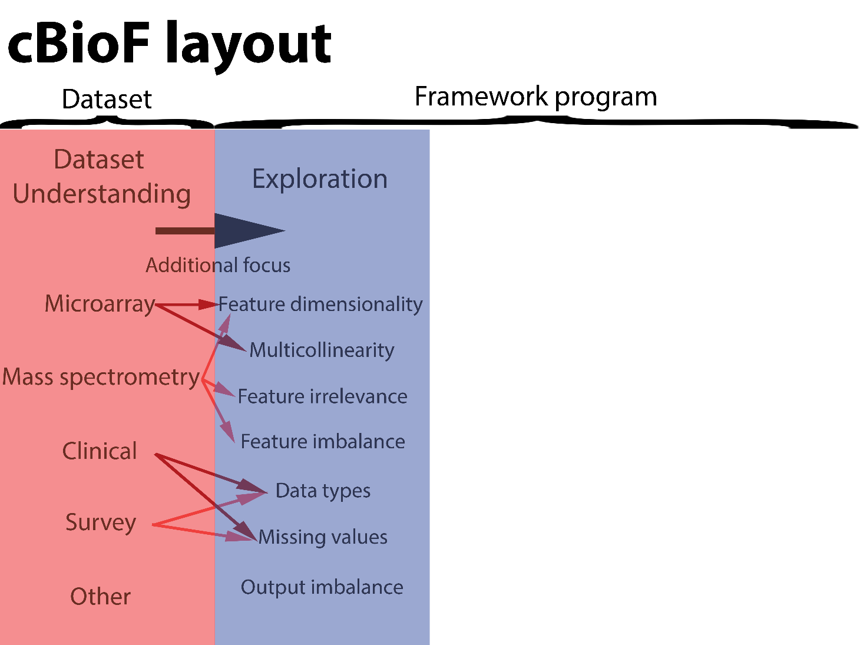

Slide 43
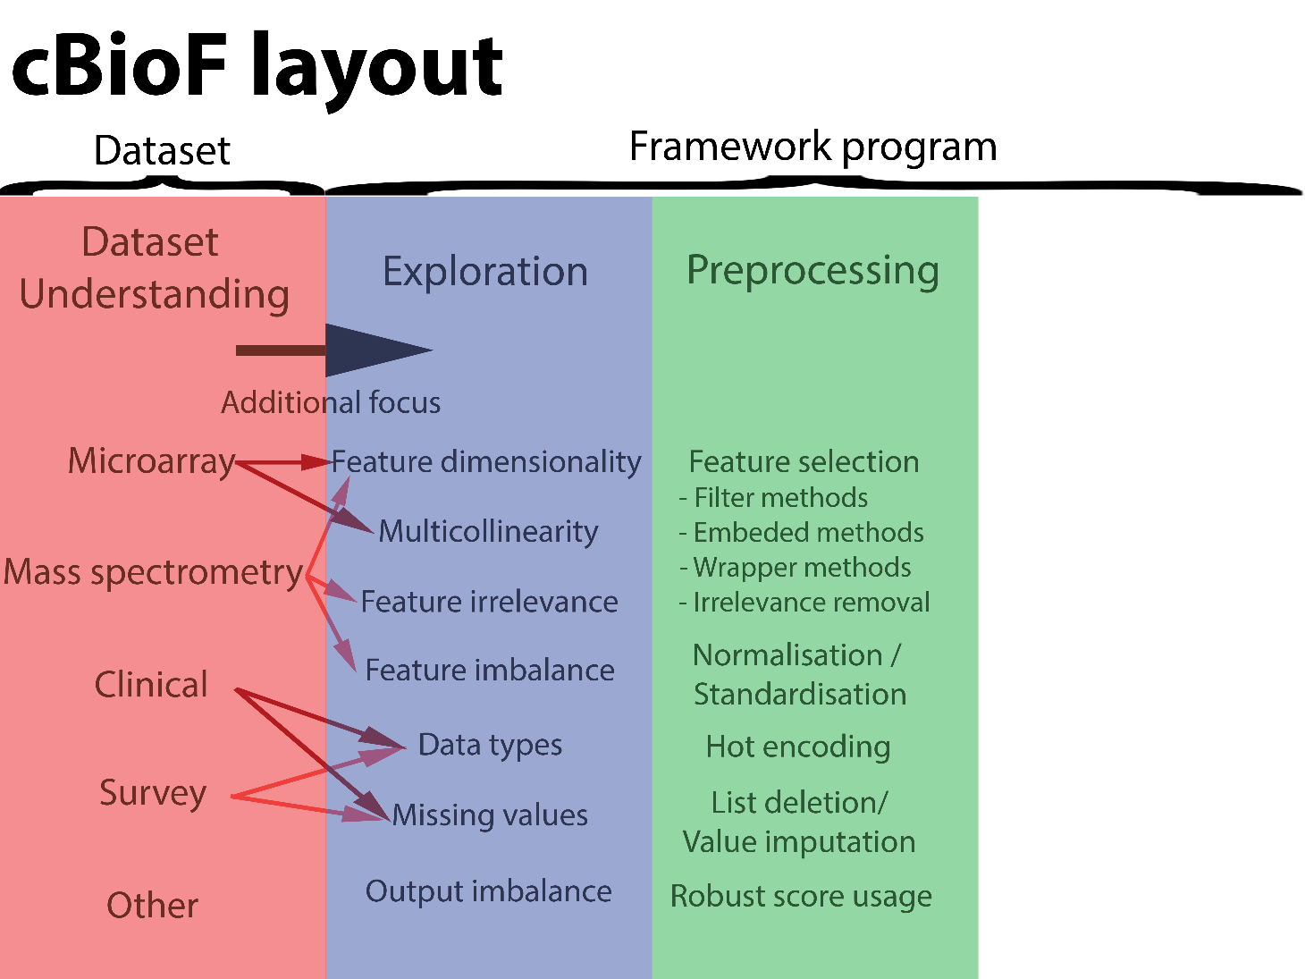

Slide 44
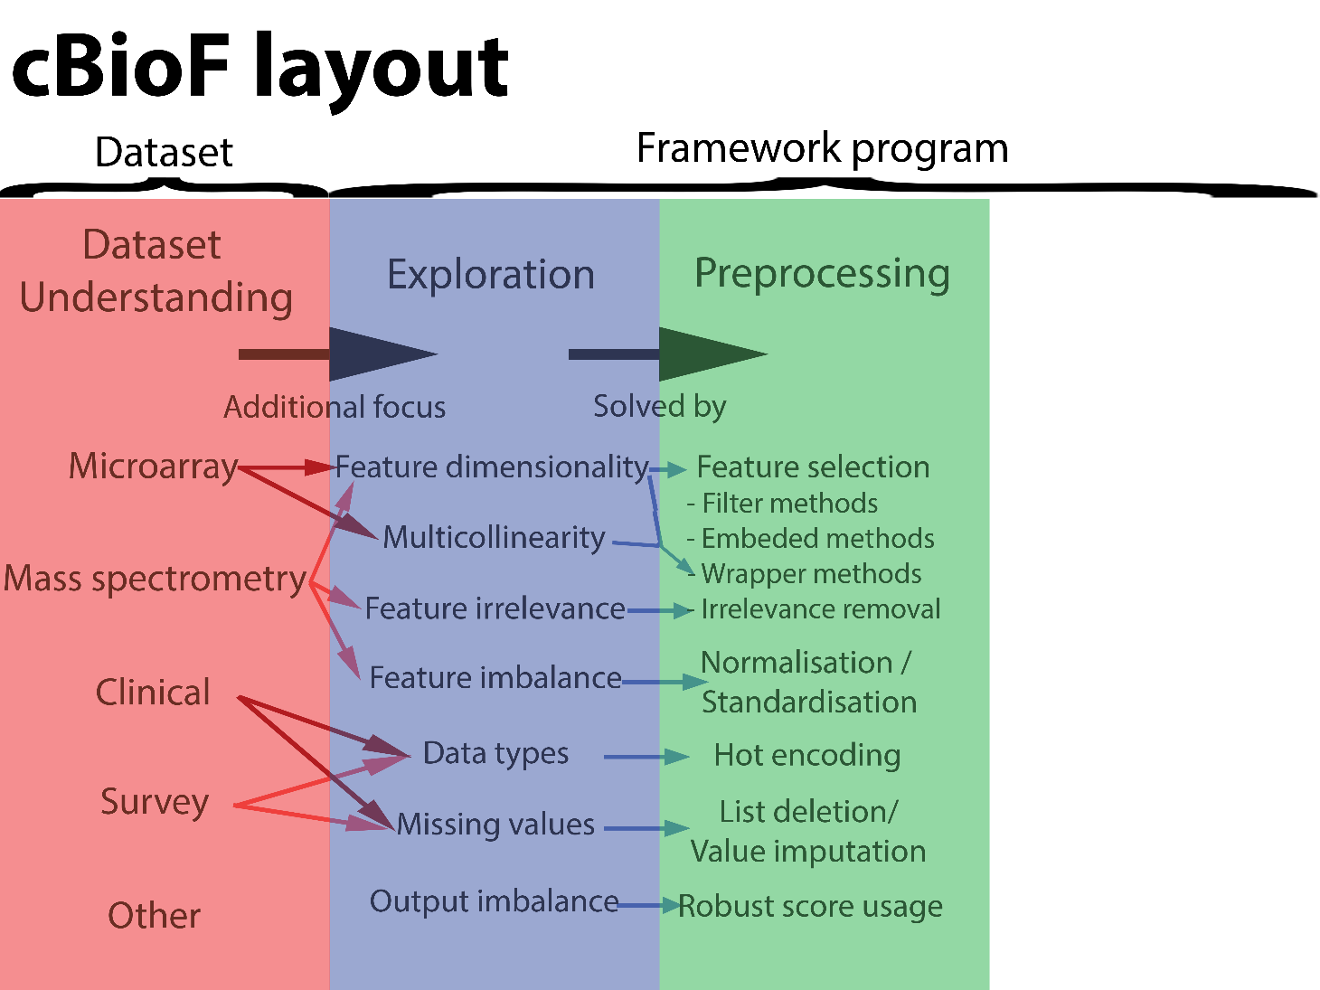

Slide 45
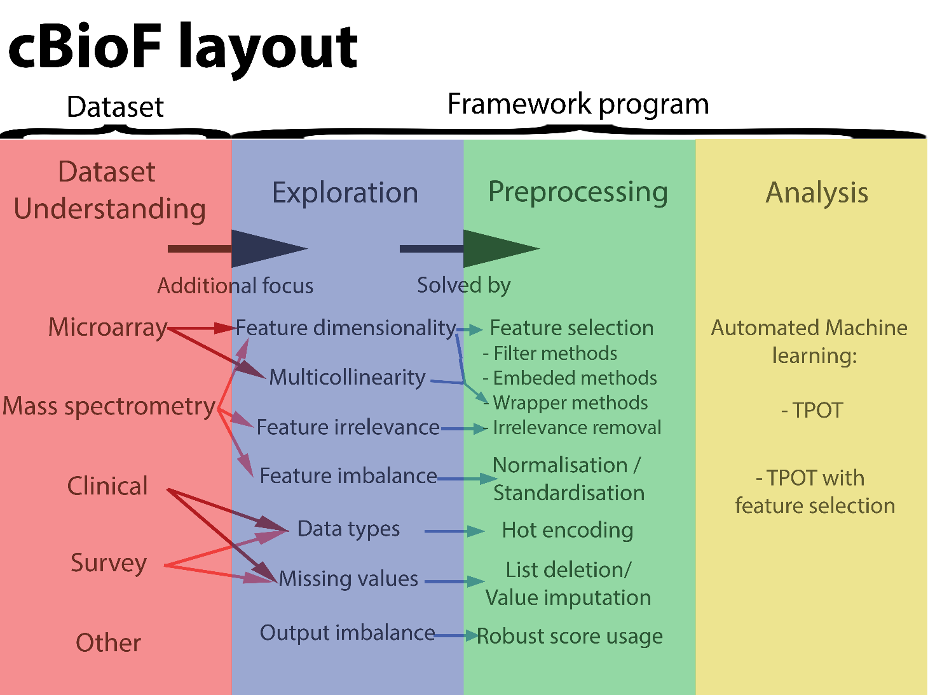

Slide 46
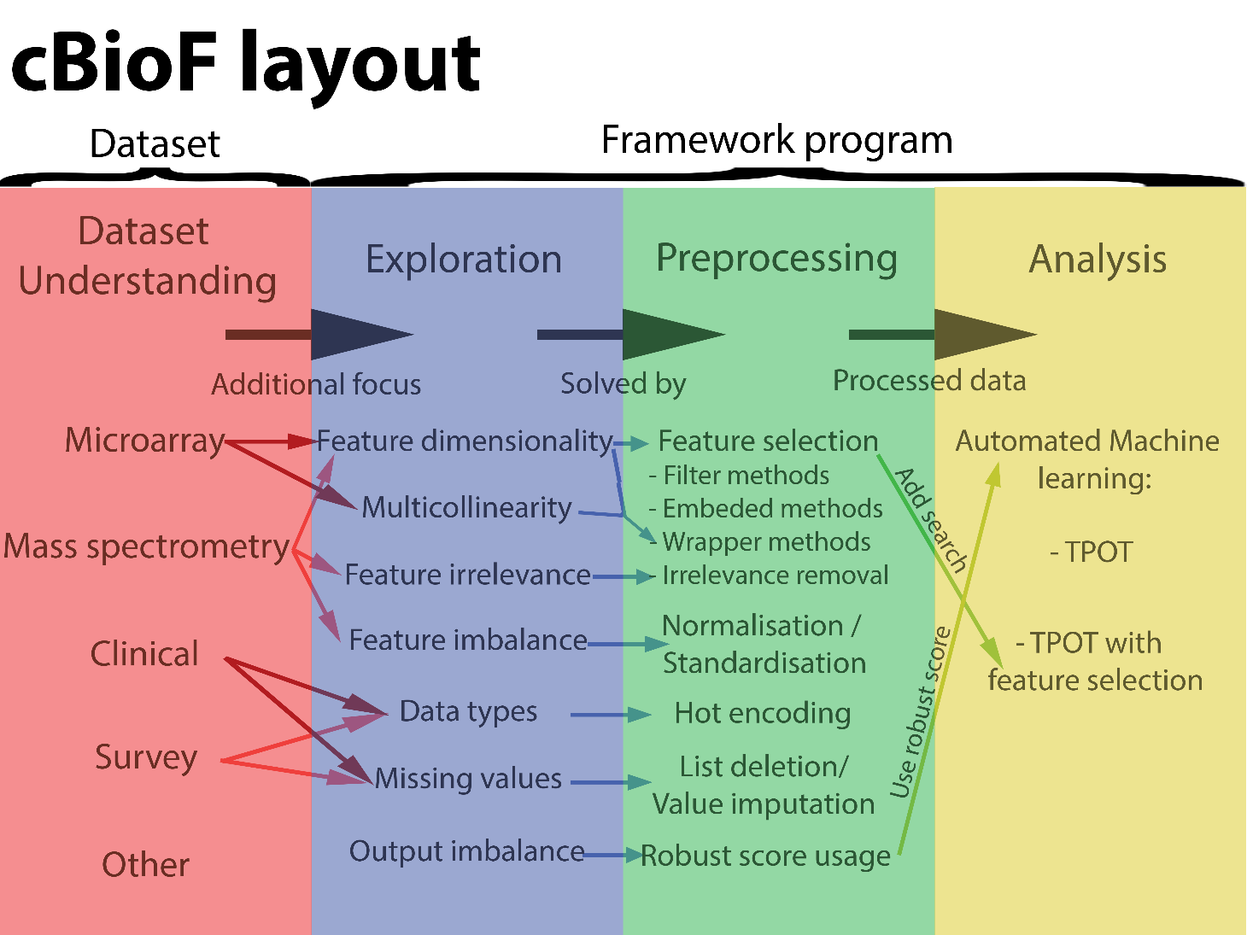
Notes:
T: 0:30
28:30

Slide 47
Conclusions
Feature selection
200 features threshold
Wrapper methods perform best
TPOT with feature selection
Missing value handling
> 15% missing values
Mean imputation
Dataset exploration
Possible with additions metalearn
Notes:
T: 0:30
29:30

Slide 48
Future work
Feature selection
200 features threshold
Combination filter and wrapper
Missing value handling
New datasets
Framework
Research on multicollinearity
Research on other dataset issues
Notes:
T: 0:30
30:00

Slide 49
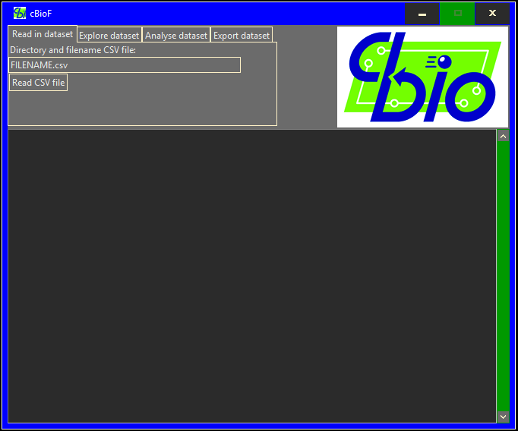
cBioF GUI
Notes:
T: 0:30
29:00

Slide 50
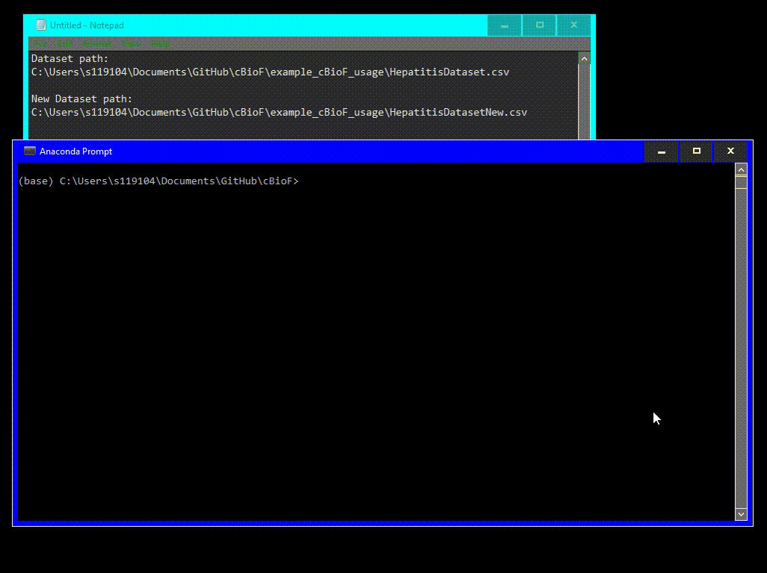
cBioF GUI
Notes:
T: 0:30
29:00

